Slide 1
Data Structures
Computer Science, Purdue University
Copyright WILEY, Goodrich and Tamassia, Data Structures And Algorithms

Slide 2
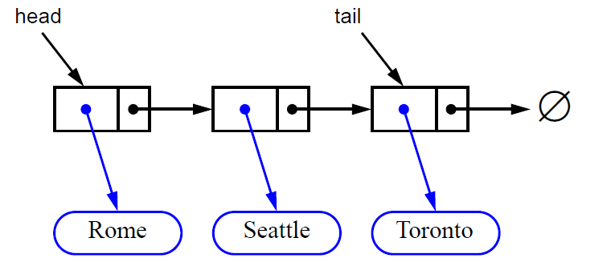
Data Structures
Queues Using a Singly Linked List
Nodes connected in a chain by links
The head of the list is the front of the queue, the tail of the list is the rear of the queue
Computer Science, Purdue University

Slide 3
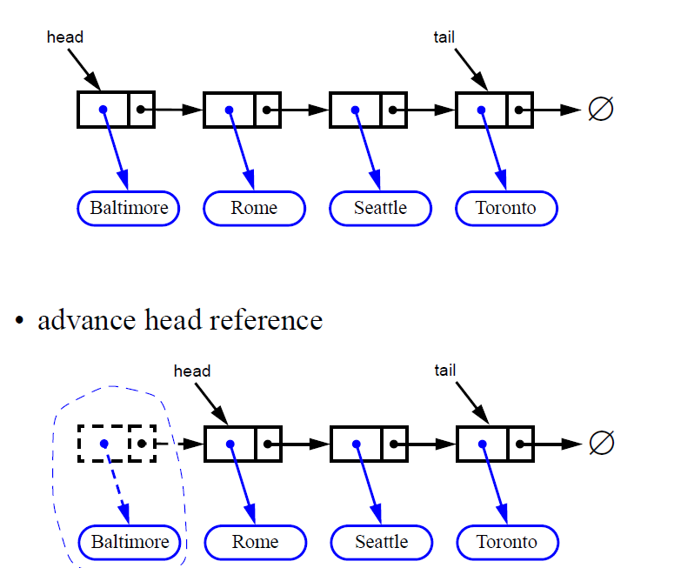
Data Structures
Removing at the Head
Computer Science, Purdue University

Slide 4
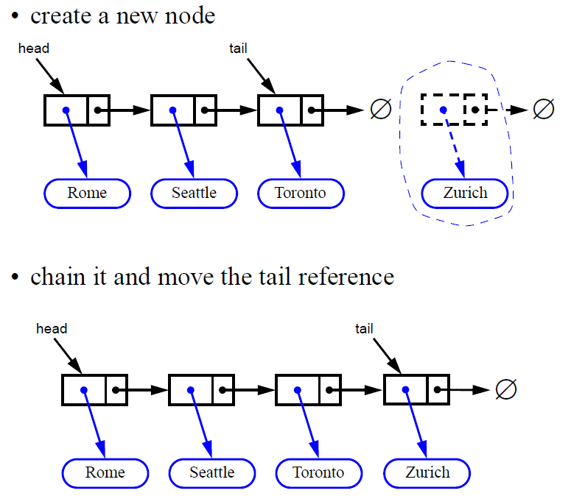
Data Structures
Inserting at the Tail
Computer Science, Purdue University

Slide 5
Data Structures
Doubly Ended Queues
A double-ended queue, or deque, supports insertion and deletion from the front and back.
The Deque Abstract Data Type
insertFirst(e): Insert e at the deginning of deque.
Input: Object; Output: none
insertLast(e): Insert e at end of deque
Input: Object; Output: none
removeFirst(): Removes and returns first element
Input: none; Output: Object
removeLast(): Removes and returns last element
Input: none; Output: Object
Computer Science, Purdue University

Slide 6
Data Structures
Doubly Ended Queues
Additionally supported methods include:
first()
last()
size()
isEmpty()
Computer Science, Purdue University

Slide 7
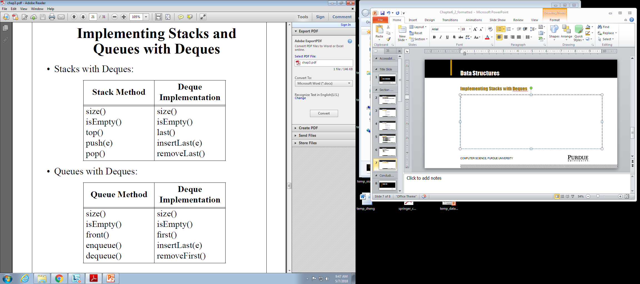
Data Structures
Implementing Stacks with Deques
Computer Science, Purdue University

Slide 8
Data Structures
Implementing Queues with Deques
Computer Science, Purdue University

Slide 9
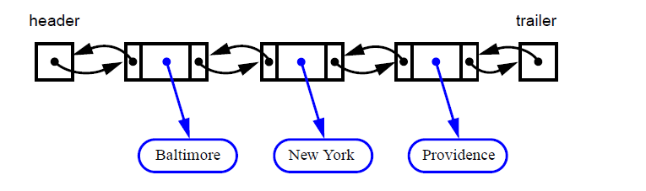
Data Structures
Implementing Doubly Ended Queues with Doubly Linked Lists
Deletions at the tail of a singly linked list cannot be done in constant time.
To implement a deque, we use a doubly linked list. with special header and trailer nodes.
Computer Science, Purdue University

Slide 10
Data Structures
Implementing Doubly Ended Queues with Doubly Linked Lists
A node of a doubly linked list has a next and a prev link. It supports the following methods:
setElement(Object e)
setNext(Object newNext)
setPrev(Object newPrev)
getElement()
getNext()
getPrev()
By using a doubly linked list to, all the methods of a deque have constant (that is, O(1)) running time.
Computer Science, Purdue University

Slide 11
Data Structures
Implementing Doubly Ended Queues with Doubly Linked Lists
When implementing a doubly linked lists, we add two special nodes to the ends of the lists: the header and trailer nodes.
The header node goes before the first list element. It has a valid next link but a null prev link.
The trailer node goes after the last element. It has a valid prev reference but a null next reference.
The header and trailer nodes are sentinel or “dummy” nodes because they do not store elements.
Computer Science, Purdue University

Slide 12
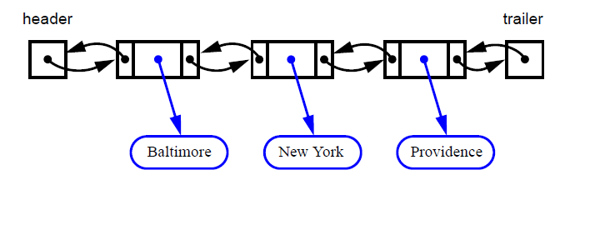
Data Structures
Implementing Doubly Ended Queues with Doubly Linked Lists
Computer Science, Purdue University

Slide 13
Thank You

